Slide 1
Tips for Preparing
Practice saying: colors, numbers, weather, emotions, questions, verbs from the LTM lessons.
You can say words, phrases and sentences.
You will have 2 minutes. Anything you say will be counted.
Really useful words:
Hay (there is) una cosa (a thing)

Slide 2
Tell the story. Say as much as you can.

Slide 3
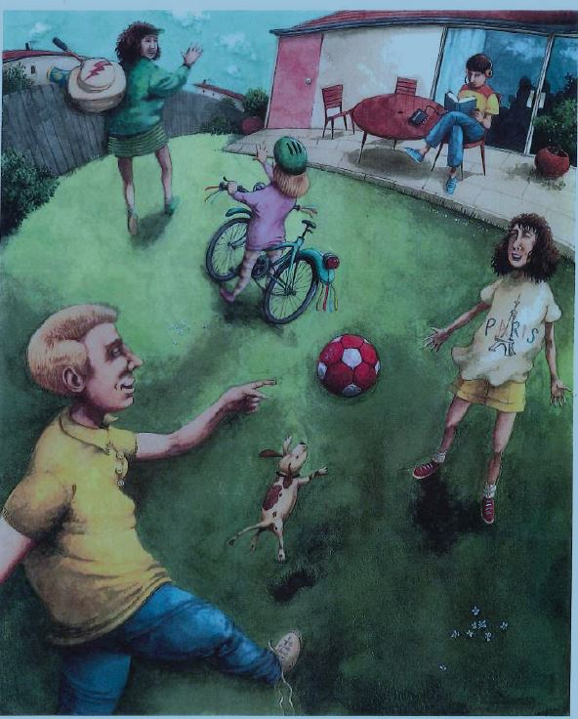
Tell the story. Say as much as you can.

Slide 4
Tell the story. Say as much as you can.

Slide 5
Tell the story. Say as much as you can.

