Slide 1
History Leading to the Modern World
International Relations
Smajda

Slide 2
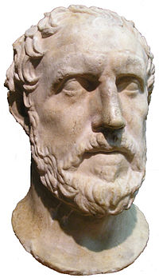
Greek and Roman Influence
Thucydides – discussions of states, actors and balance of power

Slide 3
1200’s – 1300’s (Nearing the end of the Middle Ages)
The Feudal System
Control was local by nobles, kings or emperors
The Influence of the Catholic Church
Influences of Change:
Commercial Revolution
Gunpowder Revolution
Protestant Reformation

Slide 4
1648 – The Peace of Westphalia
Sovereignty – recognized states with complete control over its territory.

Slide 5
1648-1789 Absolutism and Limited War
MONARCHY
“Subjects”, not citizens
Divine Right to Rule
Period of relative calm….why?
Limited demands of people due to limited rights
Professional armies/mercenaries
No mass nationalism
Major issues were all about territory
Shifting allegiances and alliances

Slide 6
1789-1914 The Age of Revolutions
The Emergence of Mass Nationalism: The American Revolution, The French Revolution and the Napoleonic Era
Popular Governments and wars now involving millions. Why?

Slide 7
1789-1914 The Age of Revolutions
Modern Nationalism – key components:
Emotional/physical affinity of people who share ethnic, cultural or linguistic characteristics
Popular Sovereignty- Will of the People
Ethnic or National notion of Self Determination
Development of European multinational/multiethnic states
Industrial Revolution - cheap commodities: clothes, food, railroads, guns, ammo. Weapons widen the gap between Europe and the non-Western world.

Slide 8
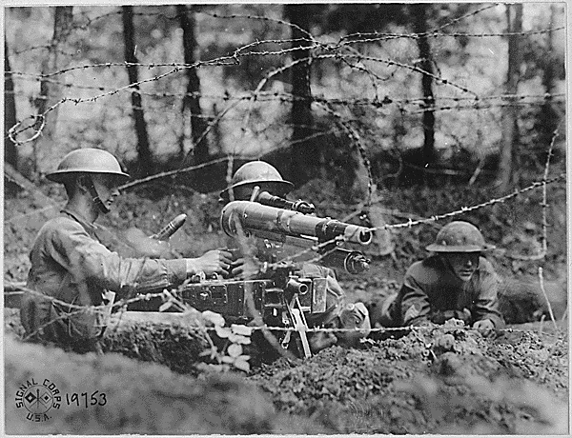
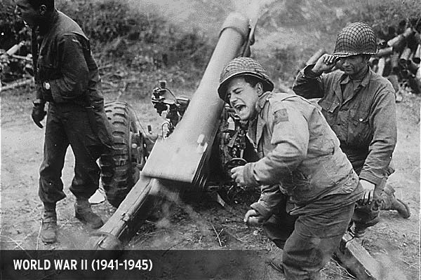
1914-1945 The Age of Total War
WWI and WWII:
Key Developments:
Total War
League of Nations to the United Nations
Treaty of Versailles
Appeasement
The emergence of the US and USSR

Slide 9
1945-1989 The Cold War
Conflict and Containment
NATO and Warsaw Pact
Domino Theory and Satellite Wars
Détente
Gorbachev – perestroika and glasnost
SAFETY OF A BI-POLAR WORLD??

