Slide 1

First Grade
We love to learn, laugh and love one another!
Supportive Parents are LifeSavers!

Slide 2
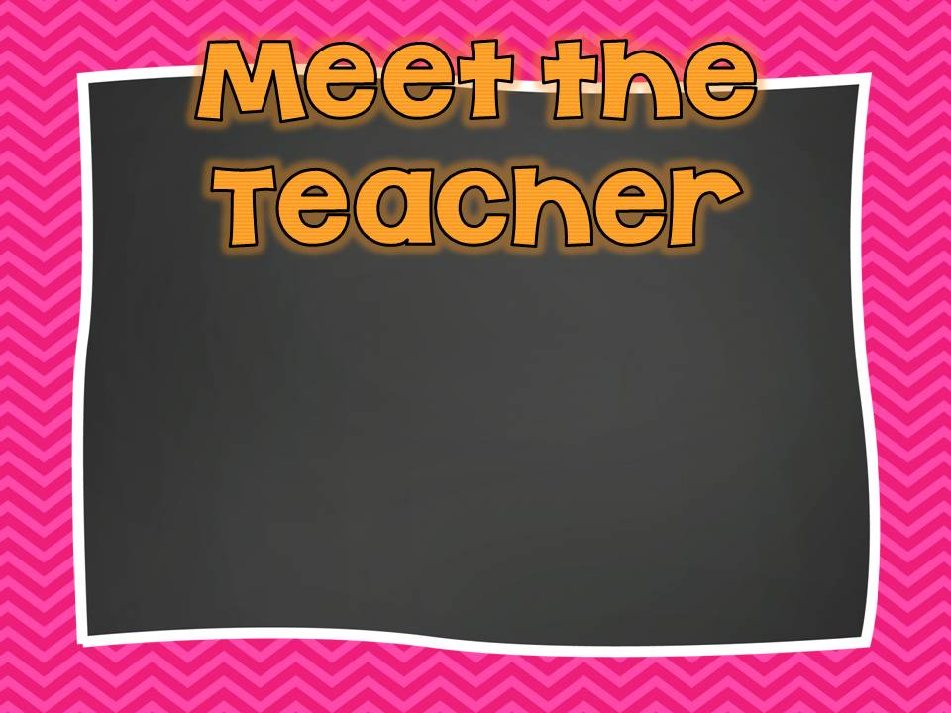

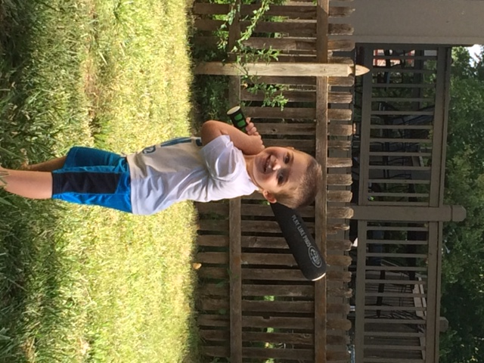
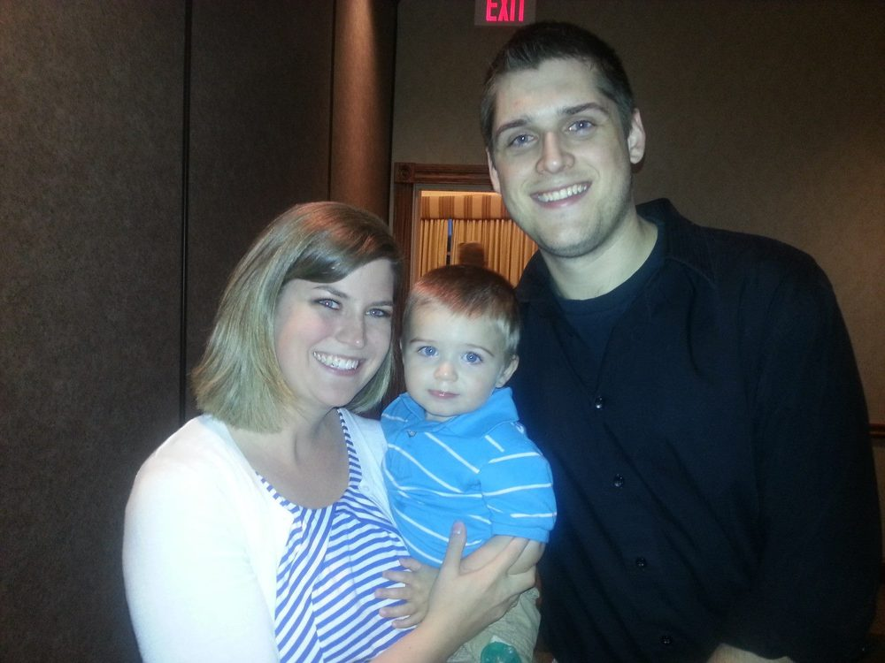

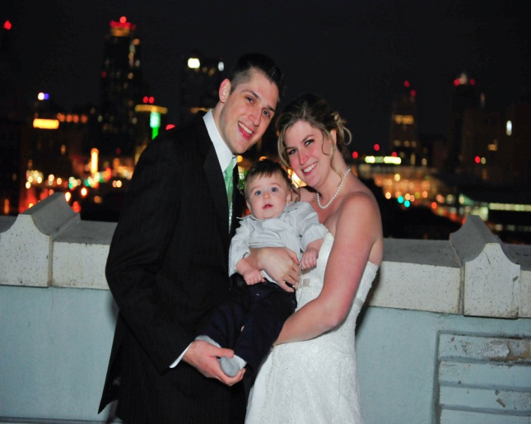

Mrs. Brown
This will be my 5th year teaching!

Slide 3

8:25-8:45: Morning Work/Attendance/Calendar
8:45-9:50: Whole Group Reading/Phonics *Snack
9:50-10:50: Specials
10:50-11:00: Fact Fluency/RR Break
11:00-12:15: Guided Reading & Rotations
12:15-12:45: Lunch
12:45-1:15: Reader’s Workshop/Library Check-out
1:15-1:50: Math
1:50-2:10: Recess
2:15-2:45: Writer’s Workshop
2:45-3:25: Science & Social Studies
3:25-3:37: Clean Up & Dismissal

Slide 4


Specials
Monday: Computer/ REAL
Tuesday: Spanish/Music
Wednesday: P.E./Spanish
Thursday: Art
Friday: Music/P.E.
Library check-out: Friday at 12:15

Slide 5
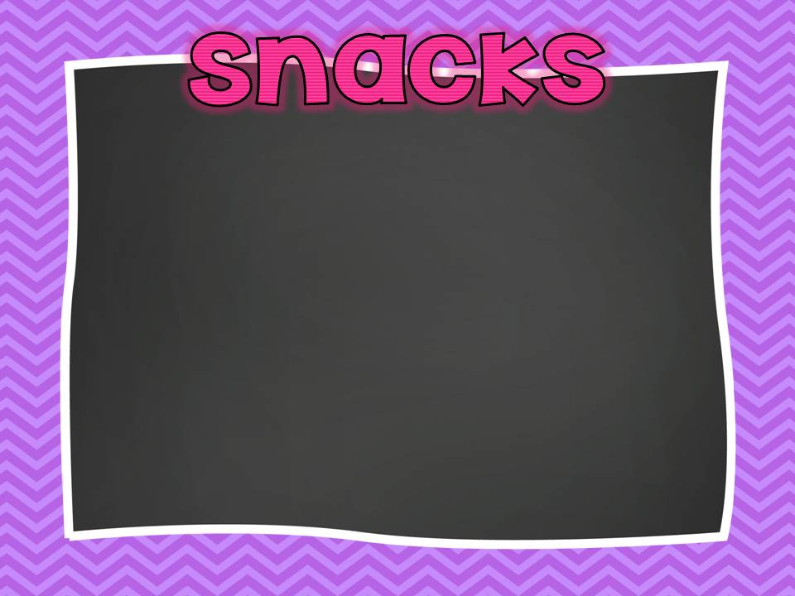

Each day students will have a
working snack time at 9:40.
Please send snacks that are: Healthy, Quick & Neat
Veggie straws
Carrot sticks
Goldfish
Crackers
Pretzels
Fruit snacks
Examples:
Grapes
Blueberries
Apple Slices
Bananas
Raisins
Granola Bars

Slide 6
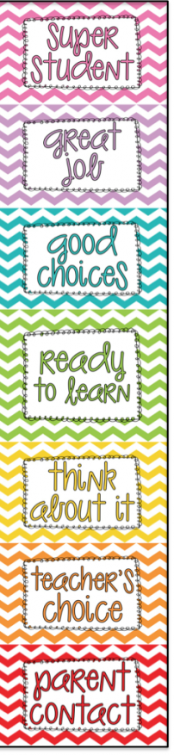
Behavior
Mrs. Brown’s class will use a clip chart to monitor behavior. A clip chart is a great tool that allows students to be rewarded for positive behavior, while discouraging negative behavior.
Everyone will start on green at the beginning of each day, and clips can be moved up and down throughout the day based on behavior.

Slide 7

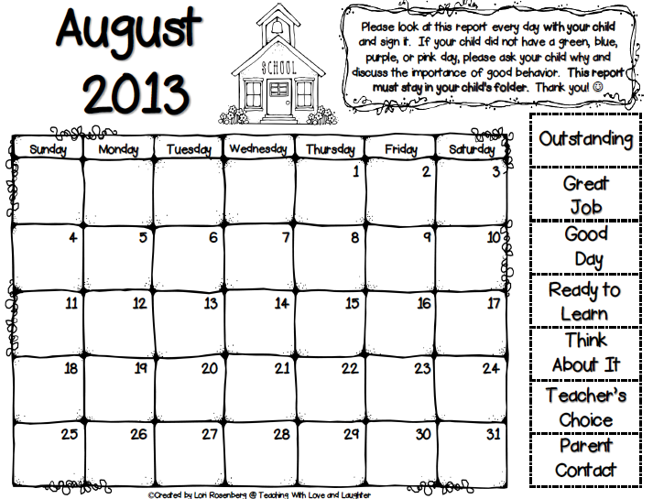
Students will record their daily behavior on their calendar.
Please keep this calendar in your child’s home folder.
Review your child’s daily behavior & sign it

Slide 8
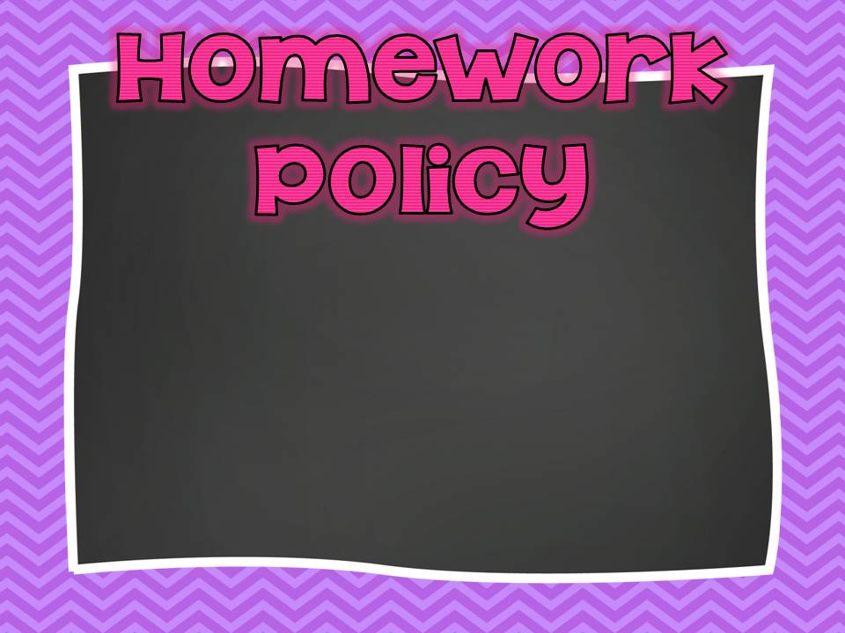
Homework will come home daily, Monday-Friday, in your child’s GREEN GO folder and will be due the next day.
A Typical Week
*Book Bags with Sight Words –Weekly
*Spelling Calendar – Monthly
Monday: Math page
Tuesday: Math page
Wednesday: Math page
Thursday: Math page
Friday: Math page
*Always check your child’s home folder!

Slide 9
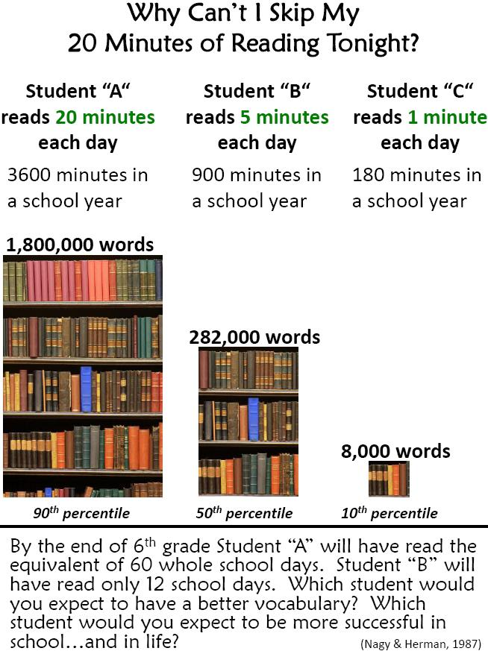
Reading Incentives:
Each month, first grade has a reading incentive- for example the September reading incentive is sharing Good Books. At the end of the each month, all of first grade will be invited to a special celebration.
To participate in the celebration, each child will need to read 12 books or 12 chapters. Your child may read to you, be read to aloud or read silently. Then you record the book or chapter on recording sheet.
Thank you for helping your child achieve the reading incentive for this school year. We appreciate your participation and support.

Slide 10


Whole Group
Interactive Reading
Introduces Theme Concepts
Key Vocabulary
Comprehension Strategies
Authentic Literature
Independent Application
and Practice
Practice
Extend Skills / Strategies
Whole Group
Cross Text Sharing
Students build on what they learned by making connections with other texts
Inquiry Projects
Small Group
Differentiated Instruction
Small Groups
Rotate through Learning Centers
Connected Literature Sets

Slide 11
Communication Arts
Guided Reading Groups
Reader’s Workshop
Spelling
Writer’s Workshop
Handwriting
Reading Incentive
Fluency Practice

Slide 12


enVision Math
Problem Based Interactive Learning
Conceptual Development for essential understanding
Students build from Concrete to Pictorial to Abstract
Uses 8 mathematical practices
1. Make sense of problems & persevere in solving them
2. Reason abstractly & quantitatively
3. Construct viable arguments & critique the reasoning of
others
4. Model with Mathematics
5. Use appropriate tools strategically
6. Attend to precision
7. Look for & make use of structure
8. Look for & express regularity in repeated reasoning

Slide 13

Daily Lesson Outline:
Part One:
Daily Review
Review key concepts from the previous day’s lessons in a
variety of ways
Part Two: Problem Based
Interactive Learning
Mathematical Conversations with peers, based on a question provided by teacher
Creating Questions
Using Manipulatives
Using Mathematical Practices
Part Three: Visual Learning,
Guided Practice,
Independent Practice &
Problem Solving
Watch Visual Learning Animation
Guided Practice Problems
Independently solve practice problems expanding on daily topic
Part Four: Close & Assess
Differentiated Instruction
Students are assessed by teacher
Students participate in learning centers
Small group instruction with teacher
for reteaching

Slide 14

Journal Writing
Story Writing
Writer’s Workshop
Mentor Text
Mini Lesson
Journals
Personal Narratives
How To
Writing for a Reason
Poetry

Slide 15

Living, Nonliving
Seasons
Decomposition
Animal Groups
Objects in the Sky
Weather
Needs of Plants and Animals
States of Matter

Slide 16

People in Communities
Economics - Needs and Wants
Maps
State of Kansas
United States &Symbols
Native American Homes
U.S. Holidays and Famous Americans
Amigo Day & Rainforest

Slide 17

Blue Valley
Virtues
Compassion is treating others the way you want to be treated.
Courage is trying new things in 1st Grade!
Honesty is telling the truth.
Perseverance is working hard to always do your best!
Respect is listening to others share.
Responsibility is taking care of school supplies and property.
Self-Discipline is following directions and making good choices.

Slide 18

Assessments
MAP for First Grade
(fall & spring)
Reading –Quarterly Individual
Assessments
Math – Topic, Quarterly & End of the Year
Spelling- Spelling Checks every 2 weeks.

Slide 19

Nov. 13 – Coterie Theater: The Wiz
(Leave school around 9:00 and return around 11:45)
We will need two volunteers.
Jan. 16 – Nelson-Atkins Museum: Shape Up! Workshop
(Leave school around 11:40 and return around 2:45)
We will need two volunteers.
March 11 – Wilderness Science Center: Animal Classifications
(Leave school around 12:20 and return around 2:45)
We will need five volunteers.
May 14 – Kansas City Zoo
(Any parents who wish to go are welcome!)
On field trip days, the students will bring their lunches and we will eat in the classroom when we return.
Please email me if you would like to volunteer for a field trip.

Slide 20

Please send a written note or email me and the office if your child will have any changes in their dismissal procedure.
If things change during the day, please call or email Sarah in the office. (ssikes@bluevalleyk12.org)

Slide 21
GO FOLDERS
Daily GO Folders (green) – Come home everyday with homework & communication from school.

Slide 22
Report Card
Progress Reports will come home in the middle of the first quarter only.
Report Cards will come home each quarter.
Expectations for the First Grade report card are different from the Kindergarten report card.
A number – 1, 2, 3 - is assigned in each subject area.
3’s are for higher level work where the student goes above and beyond what is expected for a first grade student.

Slide 23
Birthdays, Parties, Recess, and Make-Up Work
Make Up Work will be sent home when your child returns.
Recess
Lunchroom and Lunch Money
Birthdays – District Treat Guidelines (on my website)
Do not send party invitations or thank you notes to pass out at school.
Classroom and Holiday Parties – District Treat Guidelines
Water Bottles

Slide 24

Please sign up tonight, if you’d like to help out in our classroom! What to sign up for…
Parent Teacher Conferences
Reader’s Workshop
Material Preparation
Star of the Week
PTA Holiday Parties, Teacher Appreciation Week, Sunshine Representative
PTA Email Contact & Directory Sheet

Slide 25
Communication
Newsletters and Weekly Curriculum Updates (Both will be posted to my website.)
Website
Email: jlbrown03@bluevalleyk12.org
Telephone: 239-7800 or 239-7879

Slide 26

Handouts to be Returned
PTA Directory Form
Introducing… (Due Sept. 9)
Scrapbook Page (Due Sept. 19)
September Reading Incentive : Sharing Good Book (Due Sept. 30)

Slide 27
Thanks for coming tonight and sharing your first grader with me!
I look forward to a wonderful year working with you and your child!

