Slide 1
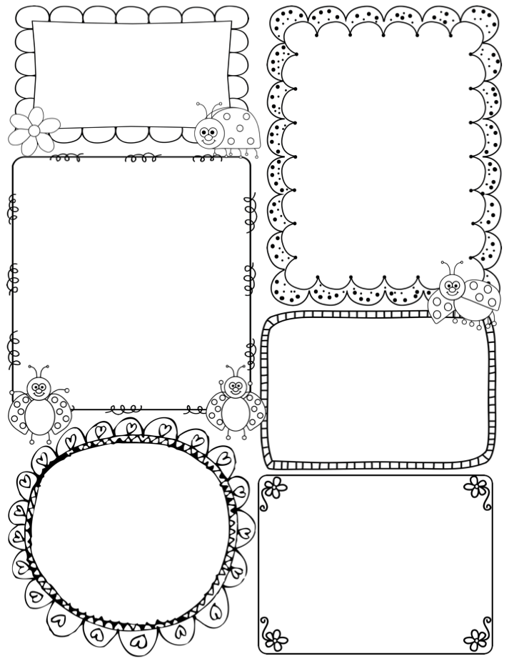
Ms. Madden’s Newsletter
September 12-September 16
Math
We start Topic 3: Learning and Reading numbers 6-10. We will work on recognizing, writing, and ordering these numbers as well as working on numbers 1-5.
Reading
Theme: All About Me
Letter: Pp
Sight Words: go, yellow. and
Skills: Listening and Producing Oral Language: Rhyme Recognition
Important Dates
9/13- Early Release
9/22- Apple Day (look out for email)
9/23- NO SCHOOL for Kindergarten kids
Science/Social Studies/Centers
We will continue learning about objects that push and pull. We will focus on what pushes and pulls do!
Specials Schedule
Monday: Day 2 Music/PE
Tuesday: Day 3 Art
Wednesday: Day 4 Spanish/Music
Thursday: Day 5 Computer/REAL
Friday: Day 1 PE/Spanish

