Slide 1
LEAD21 Literacy Instruction Literacy Instruction for the 21st Century Classrooms
Back to School Night Presentation

Slide 2
LEAD 21
What does LEAD 21 Stand for?
Literacy Expanded
Equity Ensured
Acceleration Achieved
Differentiation Refined

Slide 3
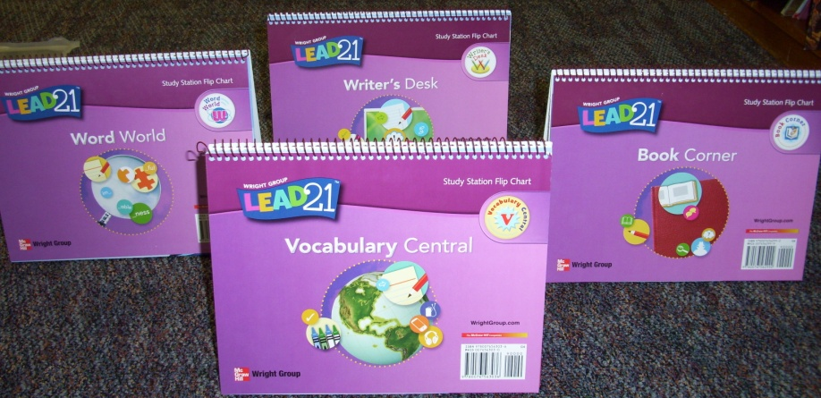
Lead 21 Components
Theme Reader
Differentiated Reader
Inquiry Project
Theme Board
Work Stations (flipcharts)
Online Tools

Slide 4
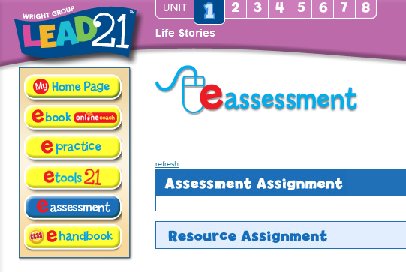
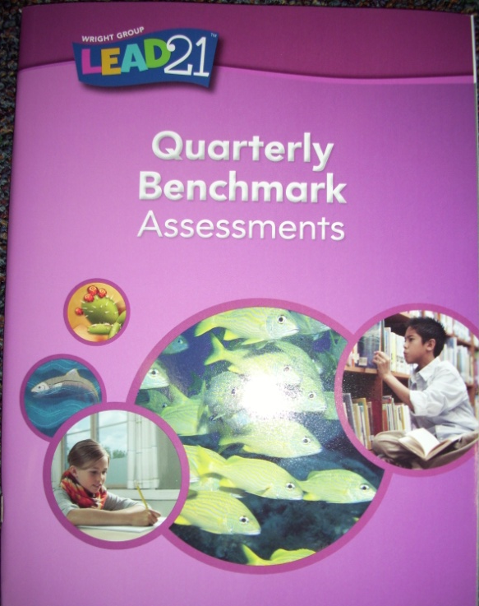
Assessments
Group Placement Test
Quarterly Benchmark Assessments
Change groups
Weekly Assessments
Online
Skills and strategies from the week
Reading Progress Assessments
Multi-dimensional fluency assessment
Differentiated Unit Assessments

Slide 5
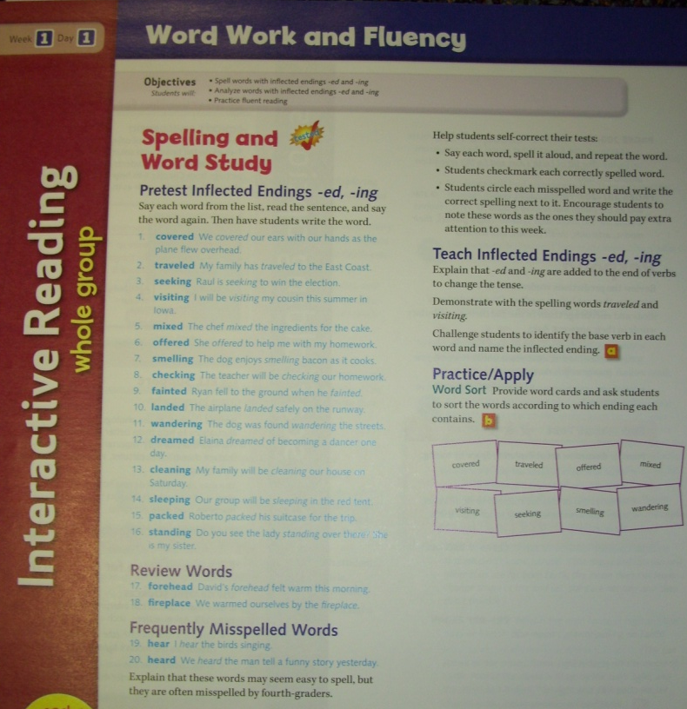
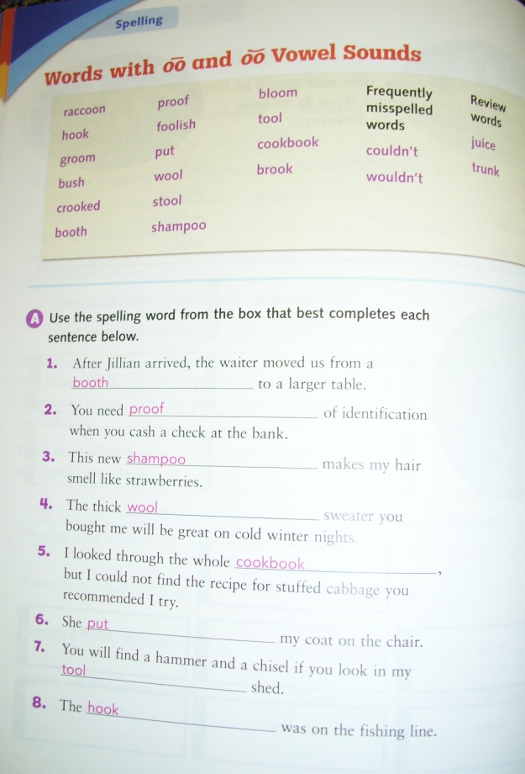
Spelling
District required
One pattern
Includes frequently misspelled words and review words
Practice companion activities

Slide 6
Highlights
Rigor
text complexity
Common Core Standards
Thematic units
Emphasis on social studies/science content
Informational Text
Inquiry
Format of series
The differentiated readers are designed to match students reading
“levels” (two grade levels below through two grade levels above)
Technology

