Slide 1
Welcome to 3rd Grade!
Ms. Morgan’s Class

Slide 2


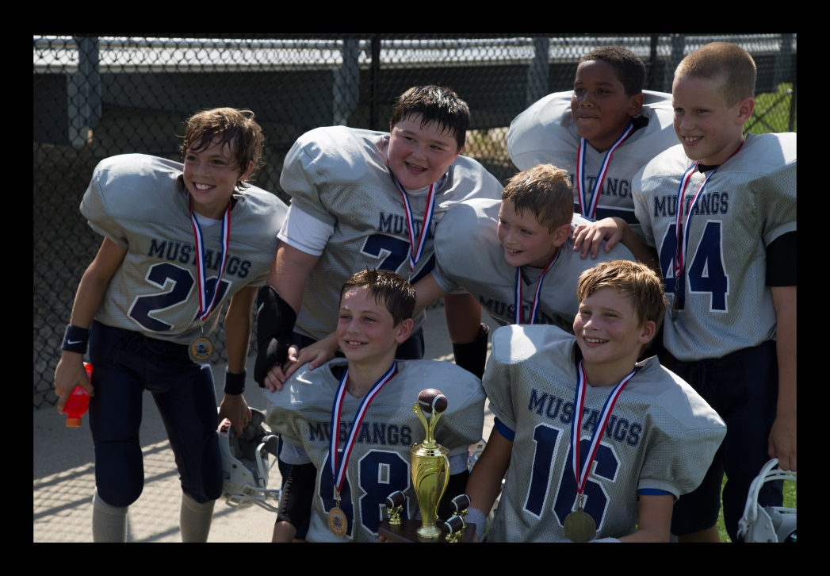

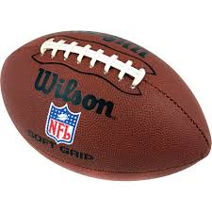
Get to know Ms. Morgan

Slide 3
Our Schedule
8: 35-8:55 Morning Work
9:00-9:30 Math Intervention
9:30- 10:15 Math
10:15-10:50 Writing/ Grammar
11:00-12:00 Specials
12:00-12:15 Morning Wrap Up
12:15-12:45 Lunch
12:45-1:05 Recess
1:15-1: 45 Reading/Language Arts (Whole)
1:45-2:15 Reading Intervention
2:15- 2:30 Recess
2:30-3:00 Reading/ Language Arts (Small)
3:00-3:25 Science/Social Studies
3:25-3:40 Pack Up & Dismissal

Slide 4
Weekly Specials
Monday: Music/Spanish
Library Checkout
Tuesday: Art
Wednesday: P.E./ Spanish
Thursday: P.E./Music
Friday: Computer

Slide 5
3rd Grade Curriculum Highlights
Reading
Lead 21
Reading Strategies
Reading Skills
Daily 5

Slide 6
3rd Grade Curriculum Highlights
Math
EnVision
Focus on Common Core Standards
Kim Sutton
Math Websites:
  Xtra math
  kidsnumbers.com
  multiplication.com
  playkidsgames.com
  funbrain.com
  factmonster.com

Slide 7
3rd Grade Curriculum Highlights
Science
Environments and Living Things
Forces and Motion
Weather and Climate
Life Cycles and Traits

Slide 8
3rd Grade Curriculum Highlights
Social Studies
The Local Community
The Economy in the Local Community
Communities in our State
Communities in our Nation

Slide 9
Spelling
Test on Fridays
Study at Home
www.spellingcity.com

Slide 10
Take Responsibility
Respectful of myself and others
Respectful of property
Responsible for my work
Responsible for my actions
Resourceful

Slide 11
BIST
B.I.S.T. helps students work on these life goals:
• I can be angry or have a strong feeling and not get in trouble.
• I can do something even if I don’t want to (or if it is hard)
• I can be okay even others are not okay.
The LES staff will partner with your child to develop skills to reach these goals.

Slide 12
BIST
The two basic rules of B.I.S.T. are:
• It is never okay to be disruptive.
• It is never okay to be hurtful.
• SAFE SEAT is a designated seat in the student’s regular classroom intended to provide a safe place where the disruptive behavior can stop. The student is not in trouble. The safe seat provides a place to keep the student out of trouble. A student can place him/herself in the safe seat as well as being assigned by an adult.

Slide 13
Morgan money
Classroom Economy Ticket System
  Students can earn tickets
  Store on Early Dismissal days
    Coupons Available for Purchase
      Teacher’s Assistant
      Fluffy Friend
      Favorite Hat
      New Pencil
      Teacher’s Chair

Slide 14
Morgan Money
Classroom Economy Ticket System
    FEES
      Planner Not Signed = 1 Ticket
      No Homework = 1 Ticket
      Leopard Violation = 1 Ticket

Slide 15
Student Planner
It is the student’s responsibility
Covers what we did that day
Tells what special we will have the next day
Homework (Read 20, study +/-, or x, Daily Math, Pearson Games, etc.)
Communication Tool
Will be checked daily
Parent Signature Required

Slide 16
Housekeeping
Birthday Treats (25 students)
  “Nut Safer” Classroom
Dismissal
Weekly Newsletter
Homework

Slide 17
Misc.
3rd Grade Musical- Feb. 22, 2017 ( 7 p.m.)
^{Grades}
^{Climate Control}
If I know about it I can probably help…
Questions?

Slide 18

Thanks for coming
We are going to have a GREAT year!

